Slide 1
Design and Analysis of Algorithms
Session 11
Convex Hull

Slide 2
Convex vs. Concave
A polygon P is convex if for every pair of points x and y in P, the line xy is also in P; otherwise, it is called concave.
x
P
x
y
P
y
concave
convex

Slide 3
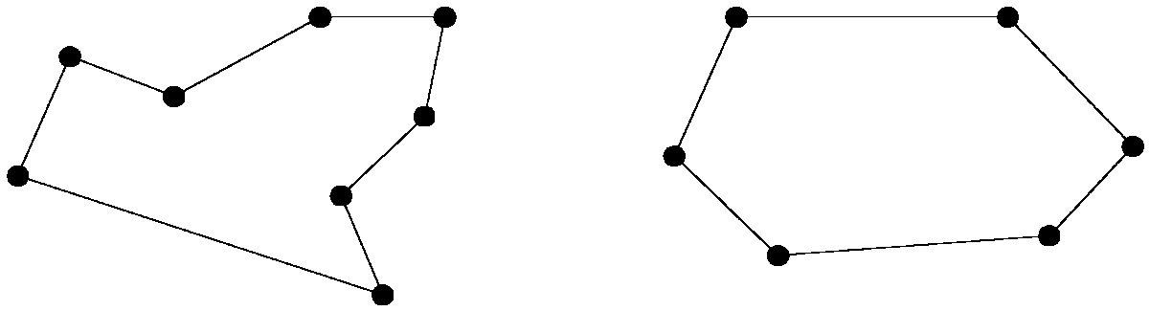
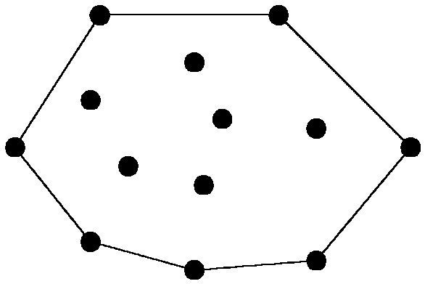
The convex hull problem
concave polygon:
convex polygon:
The convex hull of a set of planar points is the smallest convex polygon containing all of the points.

Slide 4
Graham’s Scan
Start at point guaranteed to be on the hull. (the point with the minimum y value)
Sort remaining points by polar angles of vertices relative to the first point.
Go through sorted points, keeping vertices of points that have left turns and dropping points that have right turns.
Notes:
Positive cross product is right turn, negative is left turn

Slide 5
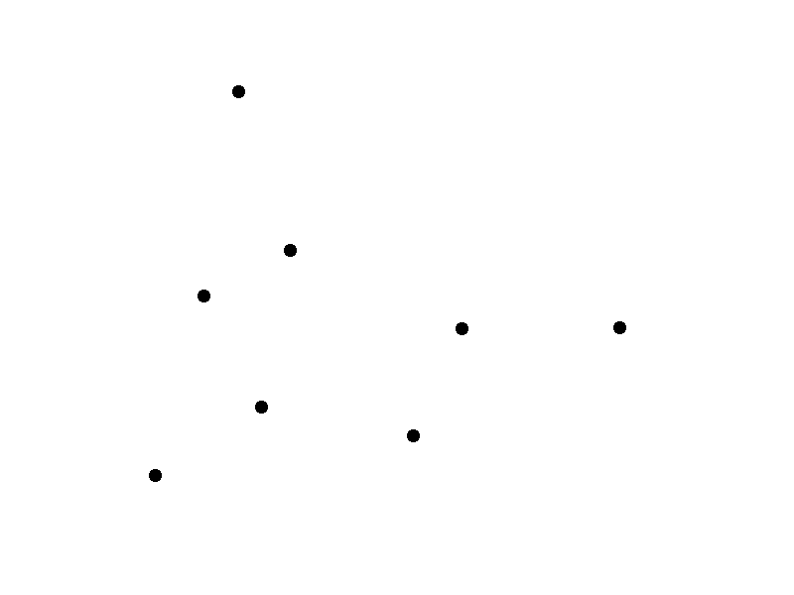
Graham’s Scan

Slide 6
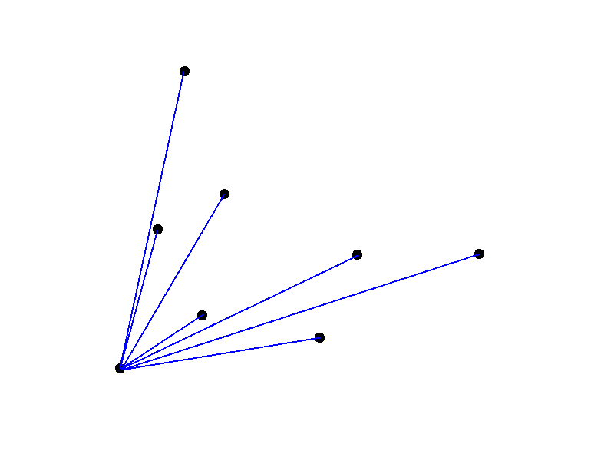
Graham’s Scan

Slide 7
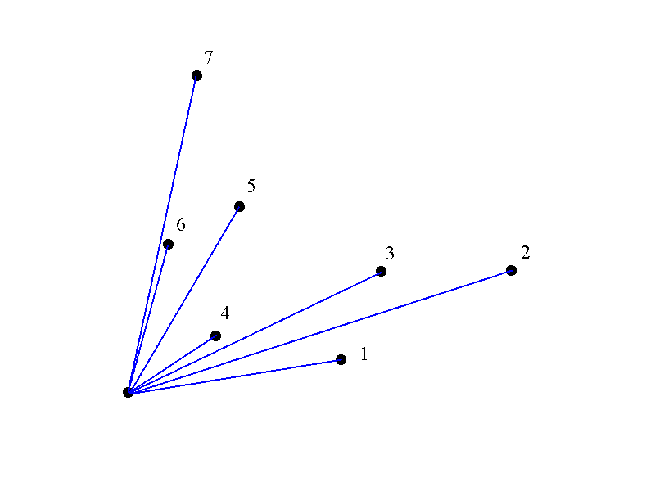
Graham’s Scan

Slide 8
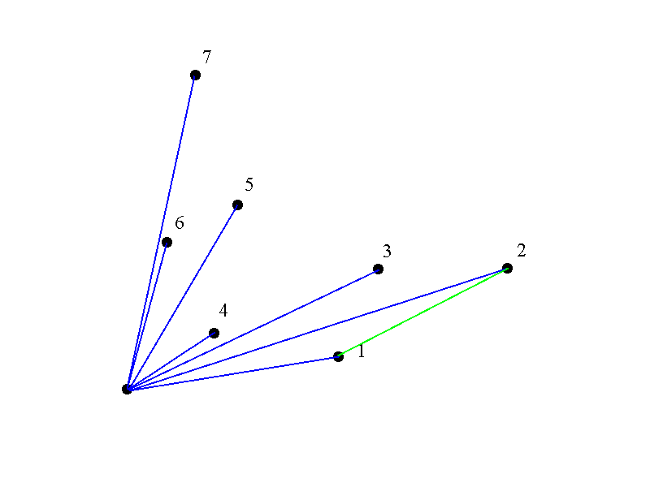
Graham’s Scan

Slide 9
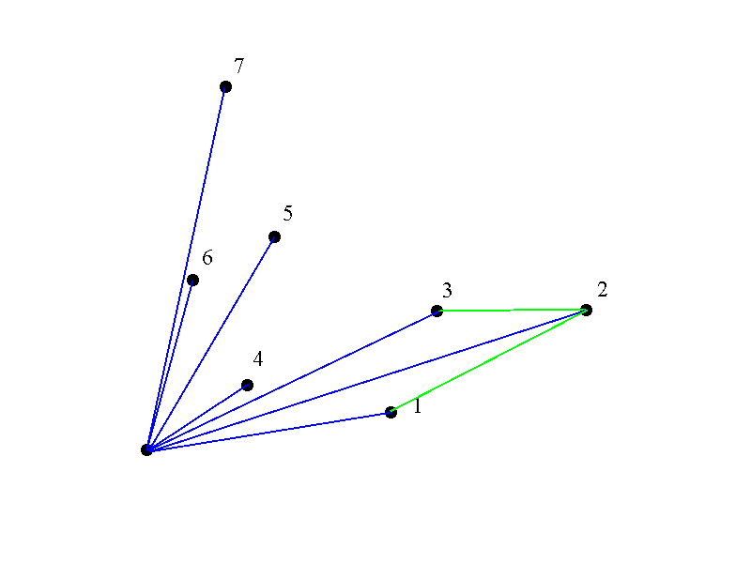
Graham’s Scan

Slide 10
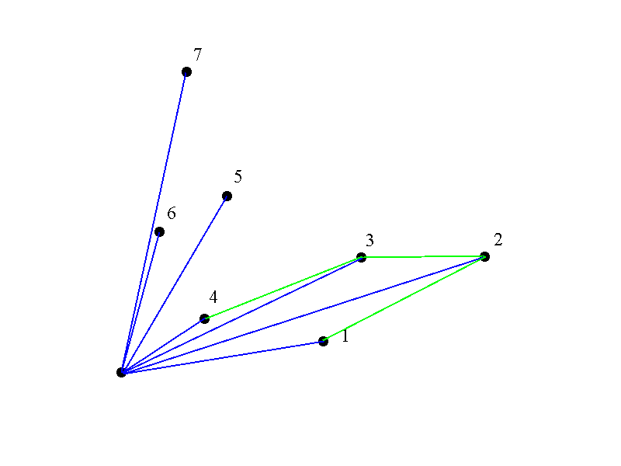
Graham’s Scan

Slide 11
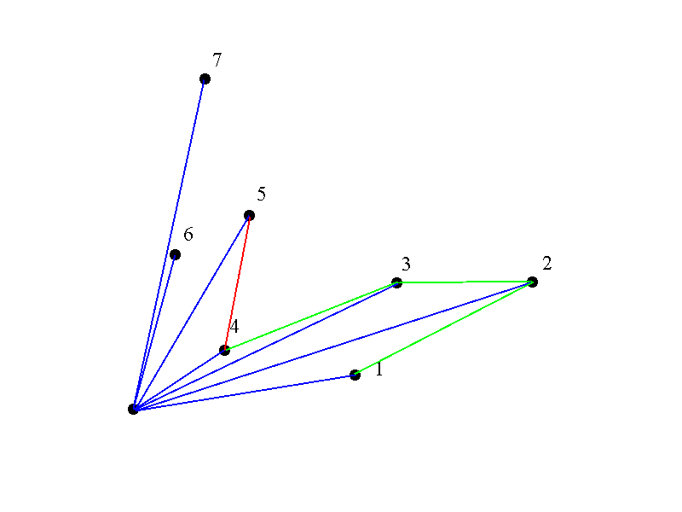
Graham’s Scan

Slide 12
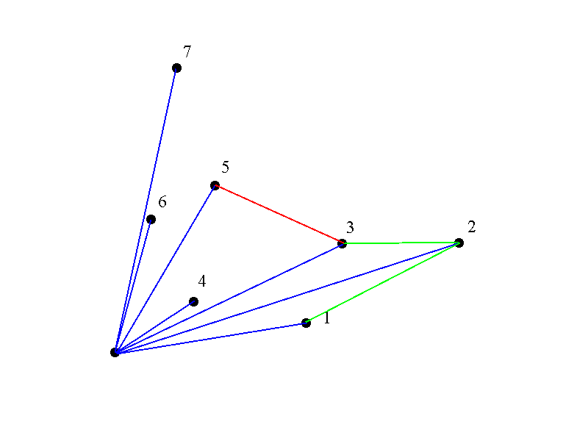
Graham’s Scan

Slide 13
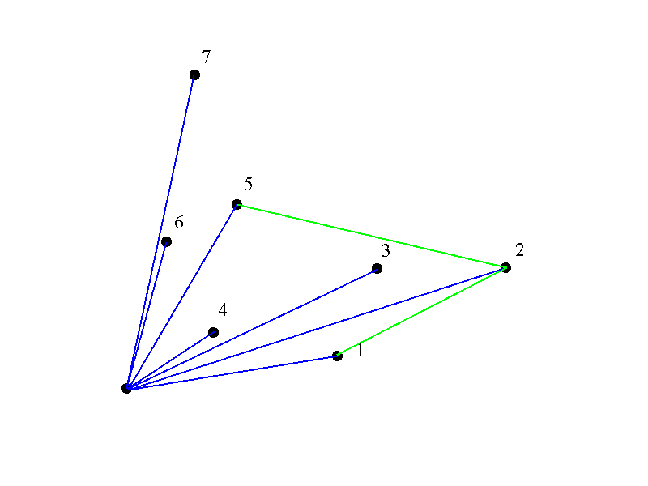
Graham’s Scan

Slide 14
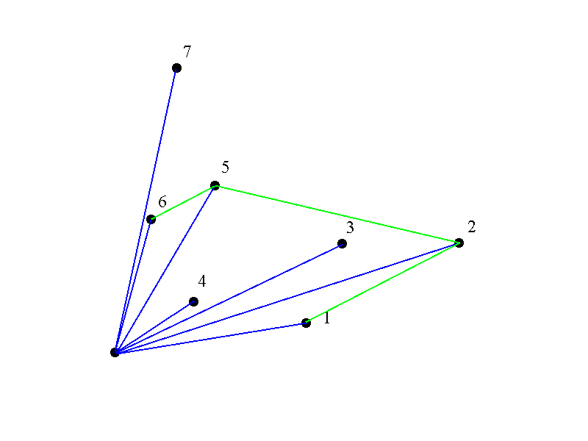
Graham’s Scan

Slide 15
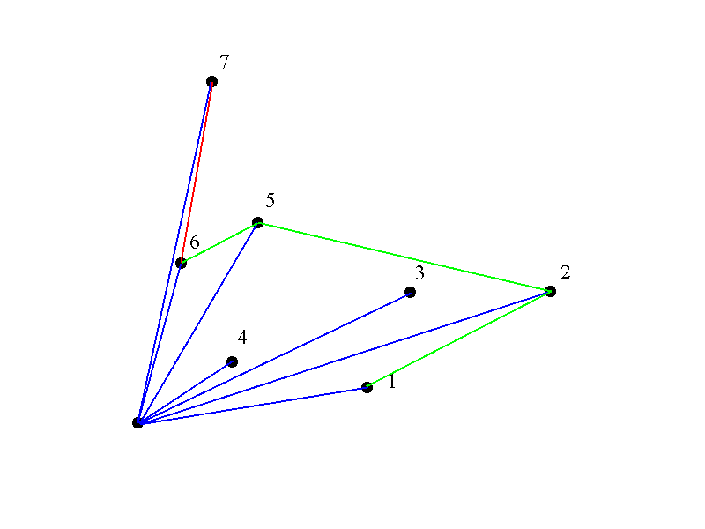
Graham’s Scan

Slide 16

Graham’s Scan

Slide 17
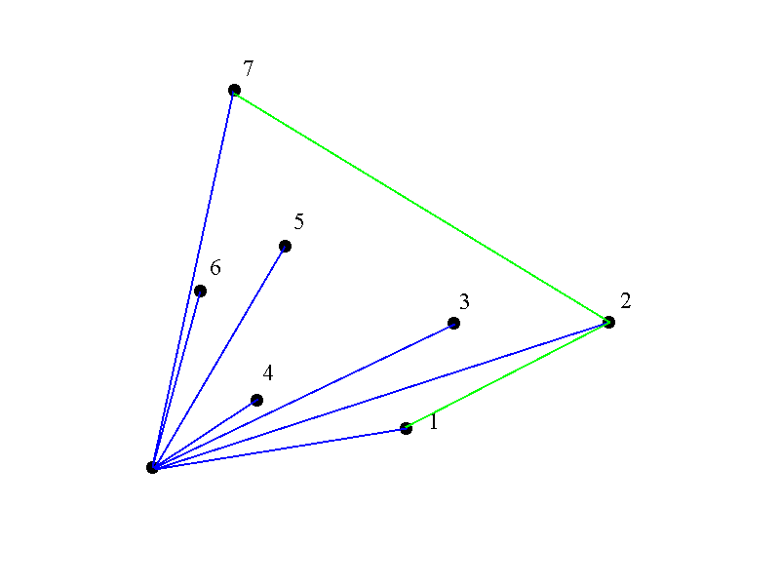
Graham’s Scan

Slide 18
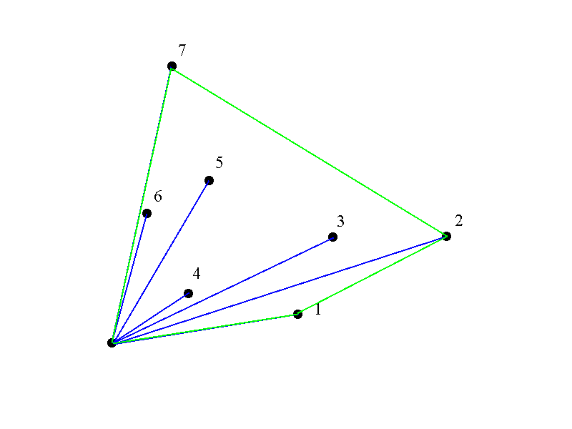
Graham’s Scan

Slide 19
Graham’s Runtime
Graham’s scan is O(n log n) due to initial sort of angles.

Slide 20
A more detailed algorithm
Graham-Scan(Q)
1. Let p0 be the point in Q with the minimum y-coordinate, or the leftmost such point in case of tie.
2. Let <p1, p2,…, pm> be the remaining points in Q, sorted by polar angle in counterclockwise order around p0(if more than one point has the same angle, remove all but the one that is farthest from p0).
3. Push(p0, S)
4. Push(p1, S)
5. Push(p2, S)
6. for i 3 to m:
7. do while the angle formed by points NEXT-TO-TOP(S), TOP(S), and pi makes a nonleft turn.
8. do POP(S)
9. PUSH(pi, S)
10. Return S

Slide 21
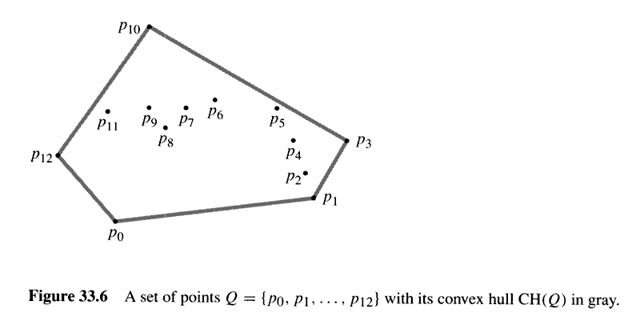

Slide 22
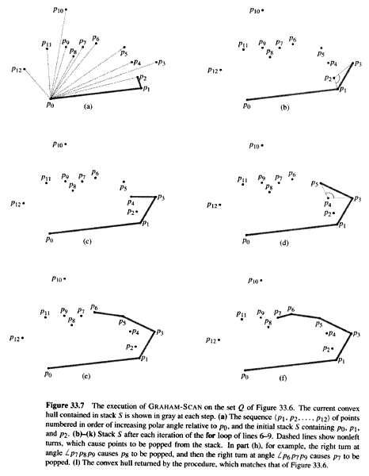
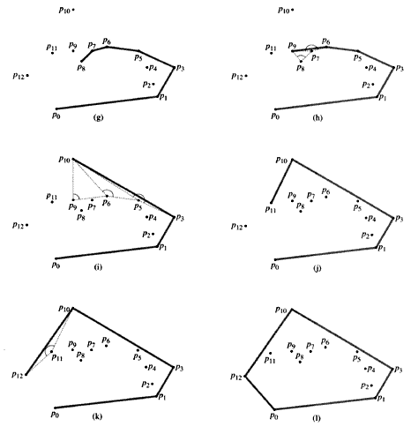

Slide 23
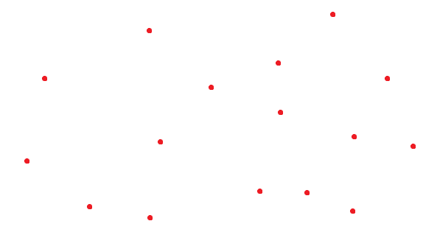
Ex: Draw the convex hull for the following points

Slide 24
Thank You

